Slide 1
Forest School
Supporting today’s children in preparation for tomorrow’s world.

Slide 2
What is Forest School?
Forest School is a long term program that runs over 36 weeks.
It assess’ participants developmental needs.
It creates learning opportunities through child led activities and themes to develop individual areas of need.
Forest School catches the child’s imagination and engages them, with an objective of deeper level learning.

Slide 3
Where did it begin?
Forest School originated in Scandinavia and was widely adopted in Denmark in 1980. It was adapted and brought to the UK in 1993 by nursery nurses from Bridgewater College.

Slide 4
What is the role of the Forest School Leader?
It is the leaders role to risk assess the site, participants and activities and to ensure they are carried out in the safest possible way. The Forest school leader will also encourage participants to be a part of risk assessing.
It is also the leaders role to observe and assess the participants and their needs. This often involves acting as a silent presence, the leader is there for support if and when it is wanted or needed.
The leader will create learning opportunities that will benefit the participant’s needs and will develop their multiple intelligences.

Slide 5
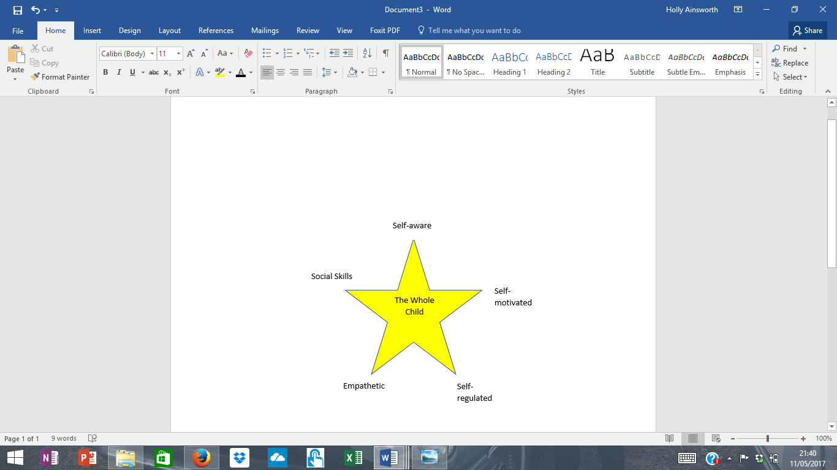
What are the benefits?
Forest School develops multiple and emotional intelligences to create a whole child. A child capable of deeper level learning and problem solving, both in the classroom and in the real world. A child who will live a long and fulfilled life.

Slide 6
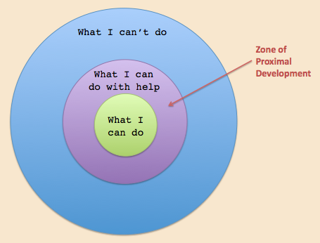
Zones of Proximal Development
At Forest School we are working to bring children into the center zone as a whole child.

Slide 7
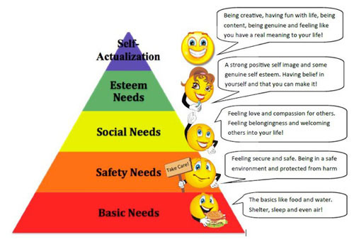
Why is kit important.
The more needs that
are met the more
a child learns
and retains.
There is no such thing as bad weather only bad clothing

Slide 8
How do we risk assess?
Probability (1-5) x Severity (1-5) = Risk Value (1-25)
What is the benefit of taking the risk?
If the RV is less than 12 and there is a benefit from taking the risk, this would be classed as an appropriate risk.
Eg. Climbing a tree up to 1.5 metres
P2 x S4 = 8
Benefits: I can challenge myself, I can motivate myself, I can conquer my fears, I can teach others how to climb safely, I can assess what risk I am comfortable with, I can make critical decisions where to place my hands and feet.

Slide 9
Tools and Fires
Tools and fires may be introduced when seen appropriate by the Forest School leader.
These are used as activities and resources to develop areas of children’s learning.
Risk assessments are done for all these activities and tool talks are given before the use of any tool.
The benefit of the use is always greater than the risk.

Slide 10
Activities
Building
Craft
Games
Planting
Moss / reflection
Singing
Team work
Campfire activities
And more

Slide 11
How might your child respond at first
Hesitant
Change in confidence
Anxious
Looking for approval or to be told what they are allowed to do before trying things

Slide 12
Optimal phrases that encourage independence
Do you have enough space for that?
Do you need help with that?
Is there a safer way to do that?
Is there a better way to do that?
Are you following the rules?
Can you create your own rules for your activity?
Can you tell them how that made you feel?
How could you make things better with your friend?

Slide 13
Rules
Sticks longer than your arm must be carried with at least one friend
Stay within the boundary
Sword fighting must be in a space away from others and with a stick distance from your partner
Three points of contact when tree climbing
We often create rules together for each activity as we go along, assessing the risk and need for rules.
Thinking Log – a place to reflect and discuss

Slide 14
How might your child feel at the end
Excited
Confident
Proud
More inquisitive
Empowered
Safe
Relaxed

Slide 15
Thank You
Thank you for taking the time to read this power point.
We hope your child enjoys Forest School and that you enjoy hearing about all the fun.
We also hope you are able to join us in the future for some parent and child sessions, in the meantime try getting outside as much as possible and asking your child to be your Forest School teacher.
Finally a few quotes to inspire you.

Slide 16
Quotes
Give me a fish and I eat for a day, teach me to fish and I eat for a lifetime
Wilderness is not a luxury, but a necessity for human spirit
There is no WI-FI in the forest but you will find a better connection
Children = 100% washable an towel dry
No one will protect what they don’t care about and no one can care about what they have never experienced – David Attenborough
Children must be kept as safe as needed not as safe a possible – we cannot eliminate risk and challenge essential for learning
Nature is a tool to get
children to experience not just the wider world, but themselves

