Slide 1
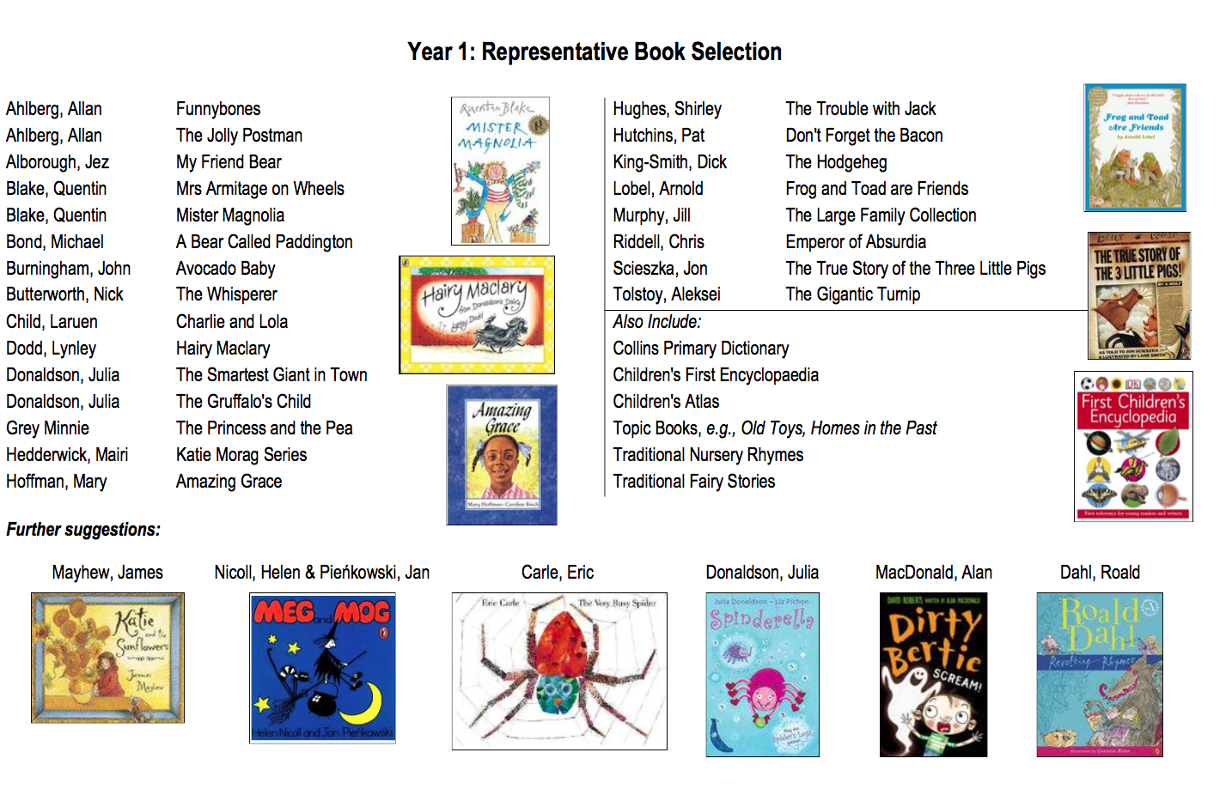
Books to buy / borrow from the library to read with your Y1 child

