Slide 1
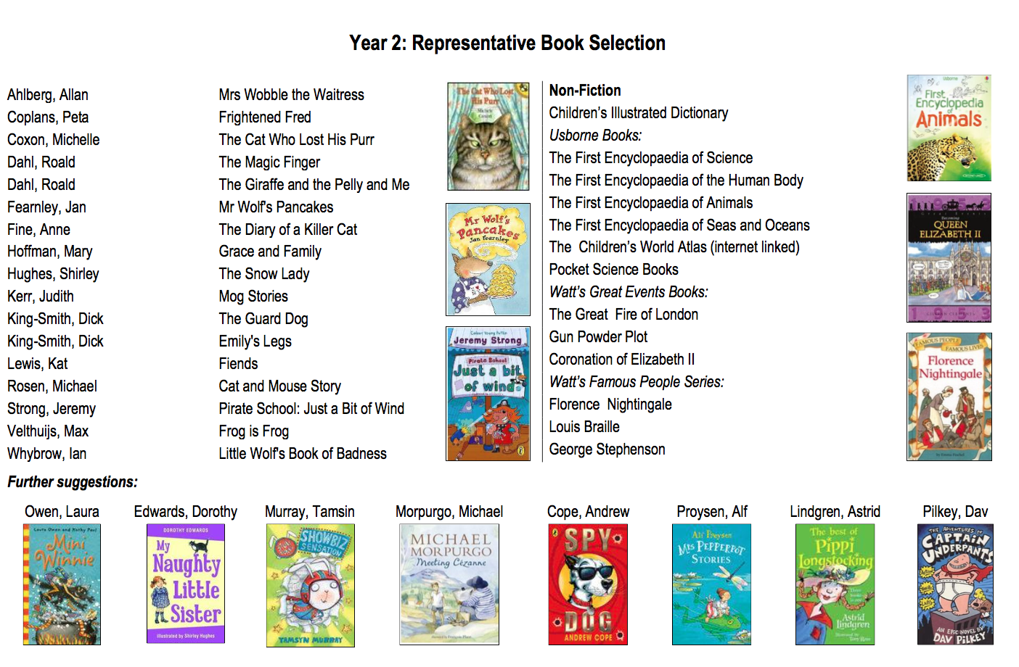
Books to buy or borrow from the library for your Y2 Child

