Slide 1
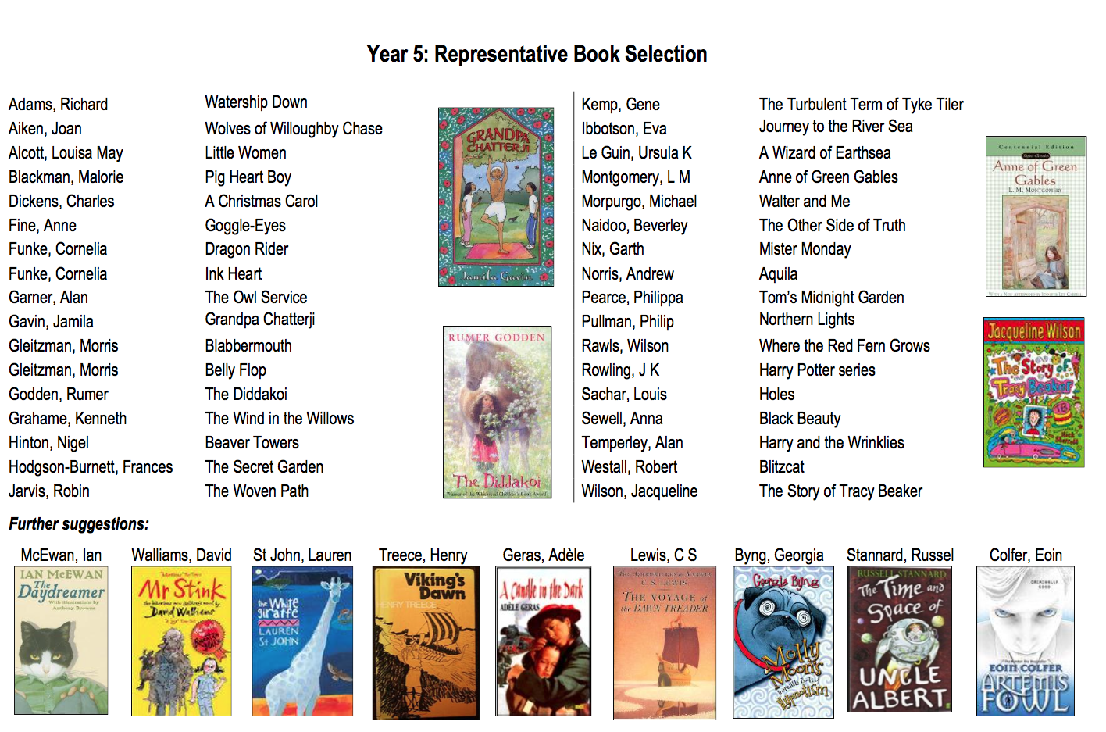
Books to buy or borrow from the library for your Y5 child

