Slide 1
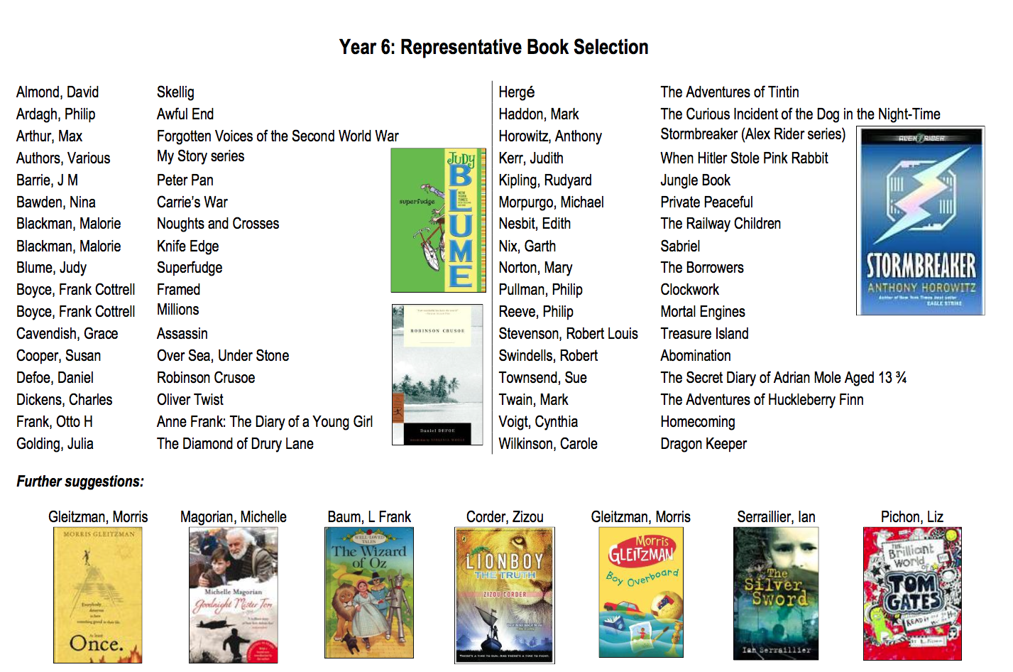
Books to buy or borrow from the library for your Y6 child

